Slide 1
Virtual Memory
60080013: Computer Organization
8th Lecture
Instructors:
Sun Heng

Slide 2
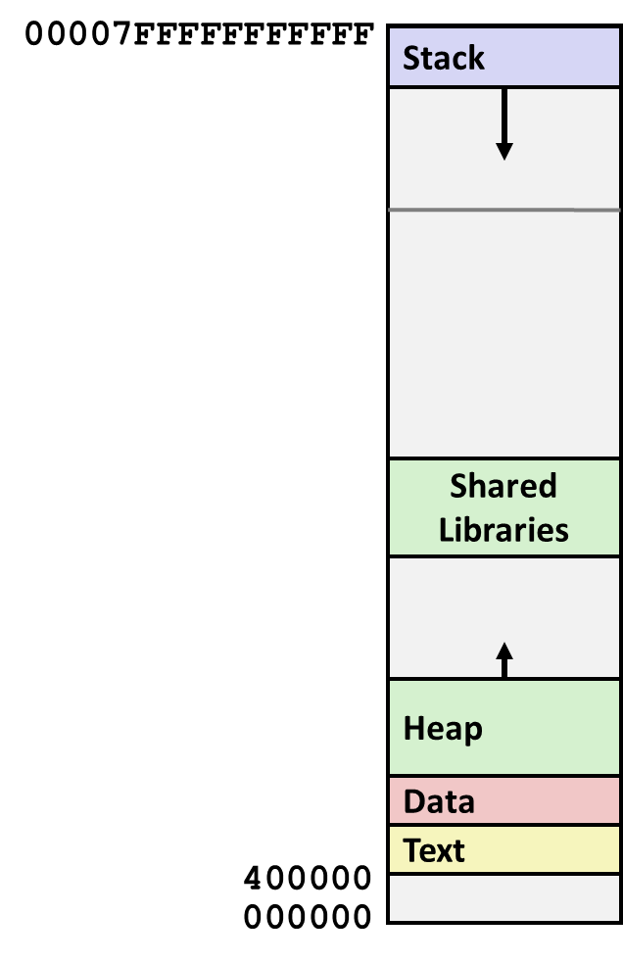
Virtual Memory
Processes in a system share the CPU and main memory with other processes. However, sharing the main memory poses some special challenges. As demand on the CPU increases, processes slow down in some reasonably smooth way. But if too many processes need too much memory, then some of them will simply not be able to run. When a program is out of space, it is out of luck. Memory is also vulnerable to corruption. If some process inadvertently writes to the memory used by another process, that process might fail in some bewildering fashion totally unrelated to the program logic.
Process 1
Process 2
Process n

Slide 3
Virtual Memory
In order to manage memory more efficiently and with fewer errors, modern systems provide an abstraction of main memory known as virtual memory (VM). Virtual memory is an elegant interaction of hardware exceptions, hardware address translation, main memory, disk files, and kernel software that provides each process with a large, uniform, and private address space.
With one clean mechanism, virtual memory provides three important capabilities:
  It uses main memory efficiently by treating it as a cache for an address space stored on disk, keeping only the active areas in main memory and transferring data back and forth between disk and memory as needed.
  It simplifies memory management by providing each process with a uniform address space.
  It protects the address space of each process from corruption by other processes.

Slide 4
A System Using Physical Addressing
The main memory of a computer system is organized as an array of contiguous byte-size cells. Each byte has a unique physical address (PA). The first byte has an address of 0, the next byte an address of 1, the next byte an address of 2, and so on. Given this simple organization, the most natural way for a CPU to access memory would be to use physical addresses. We call this approach physical addressing. This figure shows an example of physical addressing in the context of a load instruction that reads the 4-byte word starting at physical address 4.
0:
1:
Physical address
(PA)
2:
Main memory
CPU
3:
4
4:
5:
6:
7:
8:
...
M-1:
Data word
Used in some “simple” systems, like embedded microcontrollers in cars, elevators, and digital picture frames

Slide 5
A System Using Virtual Addressing
0:
CPU Chip
1:
Virtual address
(VA)
Physical address
(PA)
2:
Main memory
CPU
MMU
3:
4
4:
4100
5:
6:
7:
8:
...
M-1:
Data word
Modern processors use a form of addressing known as virtual addressing. The CPU accesses main memory by generating a virtual address (VA), which is converted to the appropriate physical address before being sent to main memory. The task of converting a virtual address to a physical one is known as address translation. Like exception handling, address translation requires close cooperation between the CPU hardware and the operating system. Dedicated hardware on the CPU chip called the memory management unit (MMU) translates virtual addresses on the fly, using a lookup table stored in main memory whose contents are managed by the operating system.

Slide 6
VM as a Tool for Caching
Virtual memory is an array of contiguous bytes that may be stored on disk
The contents of the array on disk are cached in physical memory (DRAM cache)
  These cache blocks are called pages (size is P = 2^{p} bytes)
Unallocated: Pages that have not yet been allocated (or created) by the VM system. Unallocated blocks do not have any data associated with them, and thus do not occupy any space on disk.
Cached: Allocated pages that are currently cached in physical memory.
Uncached: Allocated pages that are not cached in physical memory.
Virtual memory
Physical memory
VP 0
Unallocated
VP 1
Cached
Empty
PP 0
Uncached
PP 1
Unallocated
Empty
Cached
Uncached
Empty
Cached
PP 5
VP 7
Uncached
Virtual pages (VPs)
stored on disk
Physical pages (PPs)
cached in DRAM

Slide 7
DRAM Cache Organization
DRAM cache organization driven by the enormous miss penalty
  DRAM is about 10x slower than SRAM
  Disk is about 10,000x slower than DRAM
  Time to load block from disk > 1ms (> 1 million clock cycles)
    CPU can do a lot of computation during that time
Consequences
  Large page (block) size: typically 4 KB, sometimes 4 MB
  Highly sophisticated, expensive replacement algorithms
    Too complicated and open-ended to be implemented in hardware
  Write-back rather than write-through

Slide 8
Enabling data structure: Page Table
As with any cache, the VM system must have some way to determine if a virtual page is cached somewhere in DRAM. If so, the system must determine which physical page it is cached in. If there is a miss, the system must determine where the virtual page is stored on disk, select a victim page in physical memory, and copy the virtual page from disk to DRAM, replacing the victim page.

Slide 9
Enabling data structure: Page Table
These capabilities are provided by a combination of operating system software, address translation hardware in the MMU (memory management unit), and a data structure stored in physical memory known as a page table that maps virtual pages to physical pages. The address translation hardware reads the page table each time it converts a virtual address to a physical address. The operating system is responsible for maintaining the contents of the page table and transferring pages back and forth between disk and DRAM.

Slide 10
Enabling data structure: Page Table
A page table is an array of page table entries (PTEs) that maps virtual pages to physical pages
  Per-process kernel data structure in DRAM
Physical memory
(DRAM)
Each page in the virtual address space has a PTE at a fixed offset in the page table. For our purposes, we will assume that each PTE consists of a valid bit and an n-bit address field. The valid bit indicates whether the virtual page is currently cached in DRAM. If the valid bit is set, the address field indicates the start of the corresponding physical page in DRAM where the virtual page is cached. If the valid bit is not set, then a null address indicates that the virtual page has not yet been allocated. Otherwise, the address points to the start of the virtual page on disk.
Physical page
number or
disk address
Valid
VP 1
PP 0
PTE 0
0
null
VP 2
1
VP 7
VP 4
PP 3
1
0
1
0
null
Virtual memory
(disk)
0
PTE 7
1
VP 1
Memory resident
page table
(DRAM)
VP 2
VP 3
VP 4
VP 6
VP 7

Slide 11
Page Hit
Page hit: reference to VM word that is in physical memory (DRAM cache hit)
Physical memory
(DRAM)
Physical page
number or
disk address
Virtual address
Valid
VP 1
PP 0
PTE 0
0
null
VP 2
1
VP 7
VP 4
PP 3
1
0
1
0
null
Virtual memory
(disk)
0
PTE 7
1
VP 1
Memory resident
page table
(DRAM)
VP 2
VP 3
VP 4
VP 6
VP 7

Slide 12
Page Fault
Page fault: reference to VM word that is not in physical memory (DRAM cache miss)
Physical memory
(DRAM)
Physical page
number or
disk address
Virtual address
Valid
VP 1
PP 0
PTE 0
0
null
VP 2
1
VP 7
VP 4
PP 3
1
0
1
0
null
Virtual memory
(disk)
0
PTE 7
1
VP 1
Memory resident
page table
(DRAM)
VP 2
VP 3
VP 4
VP 6
VP 7

Slide 13
Handling Page Fault
The CPU has referenced a word in VP 3, which is not cached in DRAM. The address translation hardware reads PTE 3 from memory, infers from the valid bit that VP 3 is not cached, and triggers a page fault exception.
Physical memory
(DRAM)
Physical page
number or
disk address
Virtual address
Valid
VP 1
PP 0
PTE 0
0
null
VP 2
1
VP 7
VP 4
PP 3
1
0
1
0
null
Virtual memory
(disk)
0
PTE 7
1
VP 1
Memory resident
page table
(DRAM)
VP 2
VP 3
VP 4
VP 6
VP 7

Slide 14
Handling Page Fault
The page fault exception invokes a page fault exception handler in the kernel, which selects a victim page—in this case, VP 4 stored in PP 3.
Physical memory
(DRAM)
Physical page
number or
disk address
Virtual address
Valid
VP 1
PP 0
PTE 0
0
null
VP 2
1
VP 7
VP 4
PP 3
1
0
1
0
null
Virtual memory
(disk)
0
PTE 7
1
VP 1
Memory resident
page table
(DRAM)
VP 2
VP 3
VP 4
VP 6
VP 7

Slide 15
Handling Page Fault
If VP 4 has been modified, then the kernel copies it back to disk. In either case, the kernel modifies the page table entry for VP 4 to reflect the fact that VP 4 is no longer cached in main memory.
Kernel copies VP 3 from disk to PP 3 in memory, updates PTE 3, and then returns.
Physical memory
(DRAM)
Physical page
number or
disk address
Virtual address
Valid
VP 1
PP 0
PTE 0
0
null
VP 2
1
VP 7
VP 3
PP 3
1
Virtual memory
(disk)
1
0
0
null
VP 1
0
VP 2
PTE 7
1
Memory resident
page table
(DRAM)
VP 3
VP 4
VP 6
VP 7

Slide 16
Handling Page Fault
Offending instruction is restarted: page hit!
Physical memory
(DRAM)
Physical page
number or
disk address
Virtual address
Valid
VP 1
PP 0
PTE 0
0
null
VP 2
1
VP 7
VP 3
PP 3
1
1
0
0
null
Virtual memory
(disk)
0
PTE 7
1
VP 1
Memory resident
page table
(DRAM)
VP 2
VP 3
VP 4
VP 6
VP 7

Slide 17
Allocating Pages
Allocating a new page (VP 5) of virtual memory.
Subsequent miss will bring it into memory
Physical memory
(DRAM)
Physical page
number or
disk address
Valid
VP 1
PP 0
PTE 0
0
null
VP 2
1
VP 7
VP 3
PP 3
1
1
0
0
Virtual memory
(disk)
0
PTE 7
1
VP 1
Memory resident
page table
(DRAM)
VP 2
VP 3
VP 4
VP 5
VP 6
VP 7

Slide 18
Locality to the Rescue Again!
Virtual memory works because of locality
At any point in time, programs tend to access a set of active virtual pages called the working set
  Programs with better temporal locality will have smaller working sets
If (working set size < main memory size)
  Good performance for one process after compulsory misses
If ( SUM(working set sizes) > main memory size )
  Thrashing: Performance meltdown where pages are moved (copied) in and out continuously

Slide 19
VM as a Tool for Memory Management
Key idea: each process has its own virtual address space
  It can view memory as a simple linear array
  Mapping function scatters addresses through physical memory
    Well-chosen mappings can improve locality
0
Address
translation
0
Virtual Address Space for Process 1:
Physical
Address
Space (DRAM)
VP 1
VP 2
PP 2
...
N-1
PP 6
(e.g., read-only
library code)
Virtual Address Space for Process 2:
0
PP 8
VP 1
VP 2
...
...
N-1
M-1

Slide 20
VM as a Tool for Memory Protection
Extend PTEs with permission bits
MMU checks these bits on each access
Physical
Address Space
Process i:
SUP
READ
WRITE
Address
VP 0:
No
Yes
No
PP 6
VP 1:
No
Yes
Yes
PP 4
VP 2:
Yes
Yes
Yes
PP 2
PP 2
•
•
•
PP 4
PP 6
Process j:
SUP
READ
WRITE
Address
PP 8
VP 0:
No
Yes
No
PP 9
PP 9
VP 1:
Yes
Yes
Yes
PP 6
VP 2:
No
Yes
Yes
PP 11
PP 11

